Slide 1

SNHU Travel: Scrum-Agile Process vs Waterfall
Katherine Rangel
4/20/2025

Slide 2
Explaining Agile Roles
Scrum Master: facilitator, removes obstacles, leads daily standups, and ensures the team follows scrum practices.
Product Owner: represents the voice of the customer, defines user stories, prioritizes the backlog, and ensures the product delivers value.
Development Teams: cross-functional group of developers, designers, and testers who collaboratively deliver working increments of the product in each sprint.
In a Scrum-Agile environment, each team member has a clearly defined role that contributes to the success of the project:

Slide 3
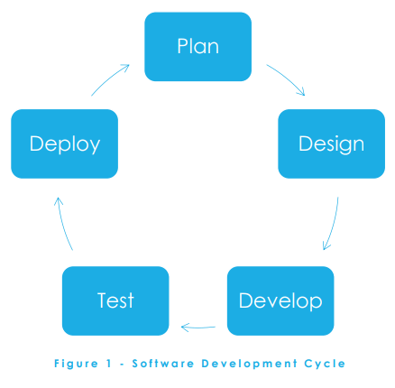
Explaining Agile Phases
Product Backlog Creation – the product owner gathers requirements and writes user stories.
Sprint Planning – the team selects backlog items to complete in the upcoming sprint.
Daily Standups – brief daily meetings to align progress and resolve blockers.
Sprint Review – the team presents completed work to stakeholders for feedback.
Sprint Retrospective – the team reflects on what went well and what could be improved for future sprints.
This Photo by Unknown Author is licensed under CC BY-SA

Slide 4
Describing Waterfall Model
Linear, sequential process: Requirements -> Design -> Implementation -> Testing
-> Deployment
No going back to earlier stages
Less flexibility to change
Comparison Example: If the search feature had been added mid-project, Waterfall would have a delayed delivery.

Slide 5
Choosing Waterfall vs. Agile
Use Waterfall for: Stable requirements and for regulatory environments
Use Agile for: Rapid iteration, evolving needs, and user feedback

Slide 6
Final Recommendation
Scrum-Agile allowed our team to collaborate, adapt, and deliver more efficiently.
Recommend Agile for the SNHU Travel project based on flexibility and team engagement.

Slide 7
References
Beck, K. et al. (2001). Manifesto for Agile Software Development.
Sommerville, I. (2016). Software Engineering (10th ed.).
VersionOne. (2023). State of Agile Report.
Scrum.org or AgileAlliance.org documentation

